Slide 1
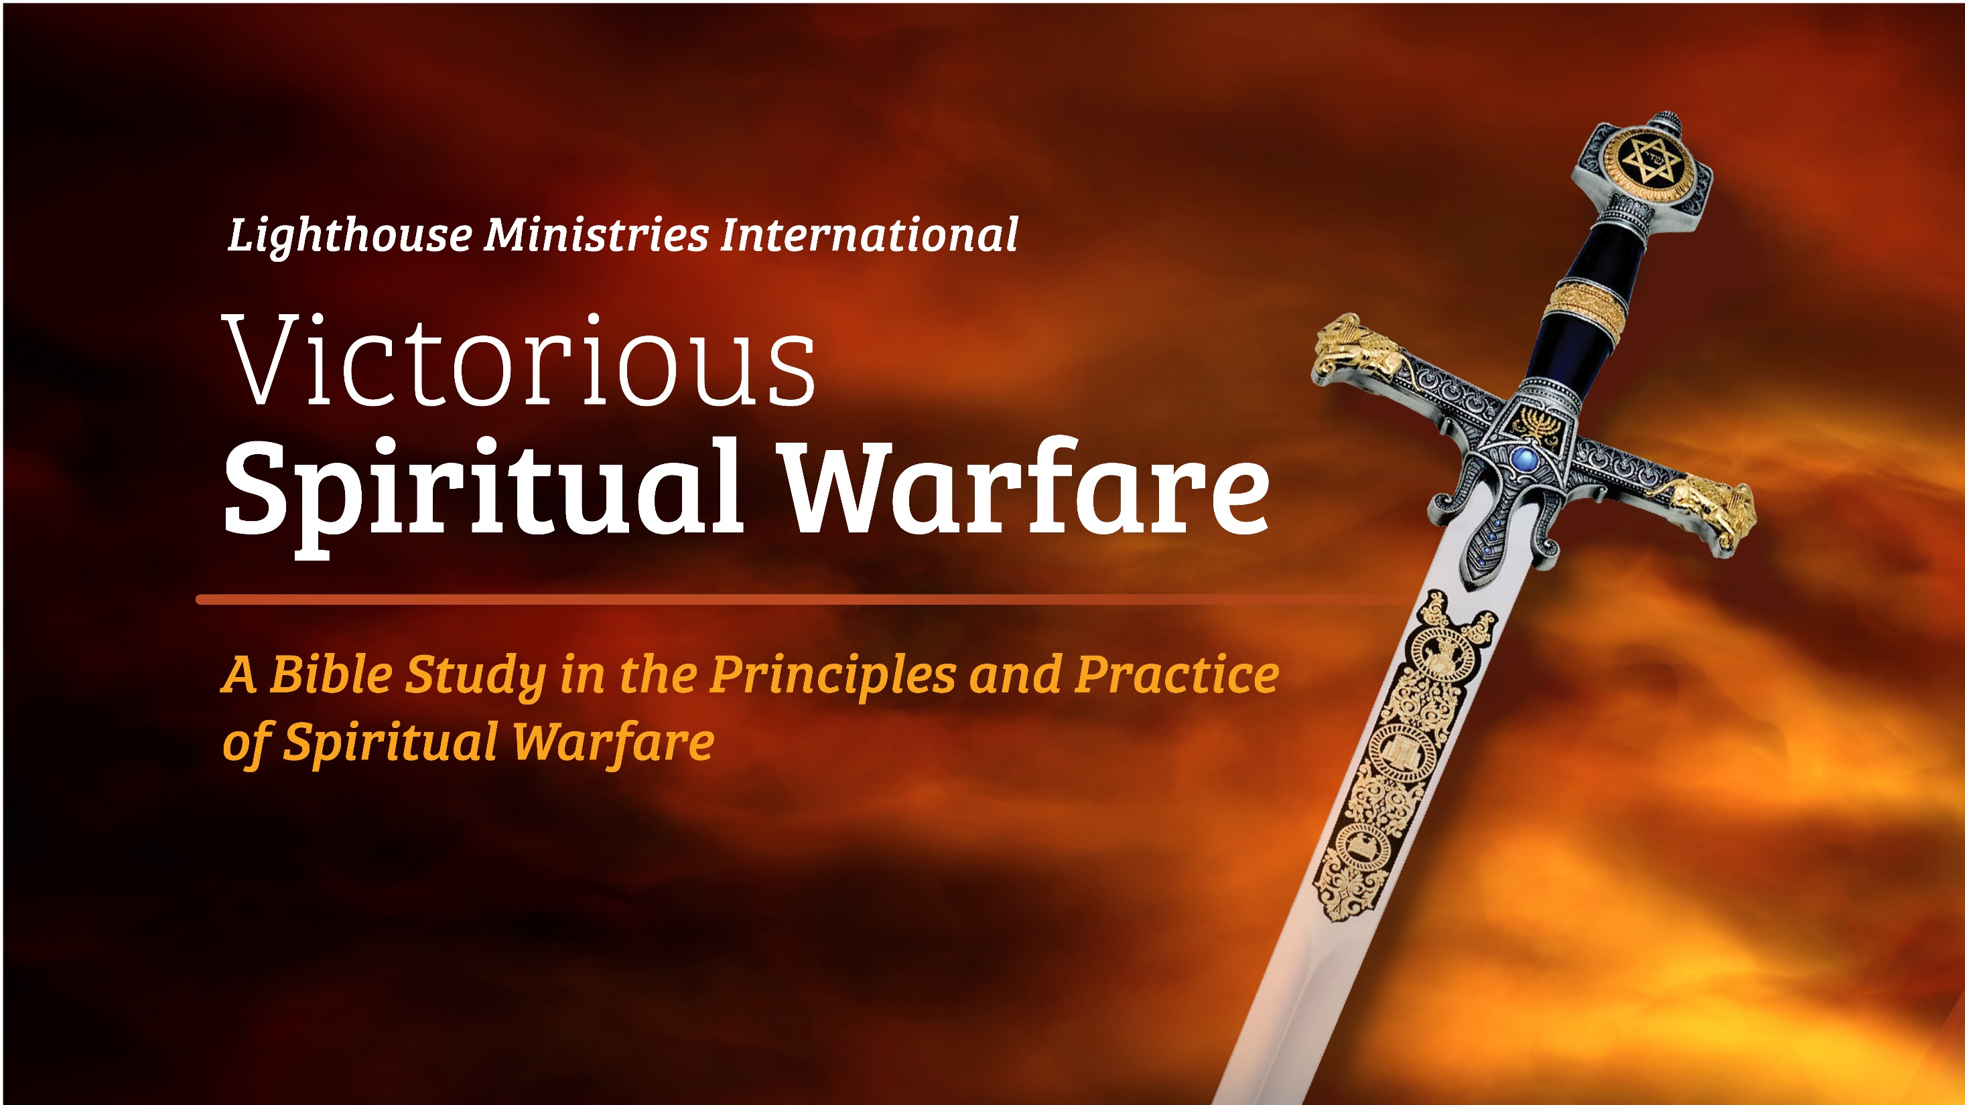
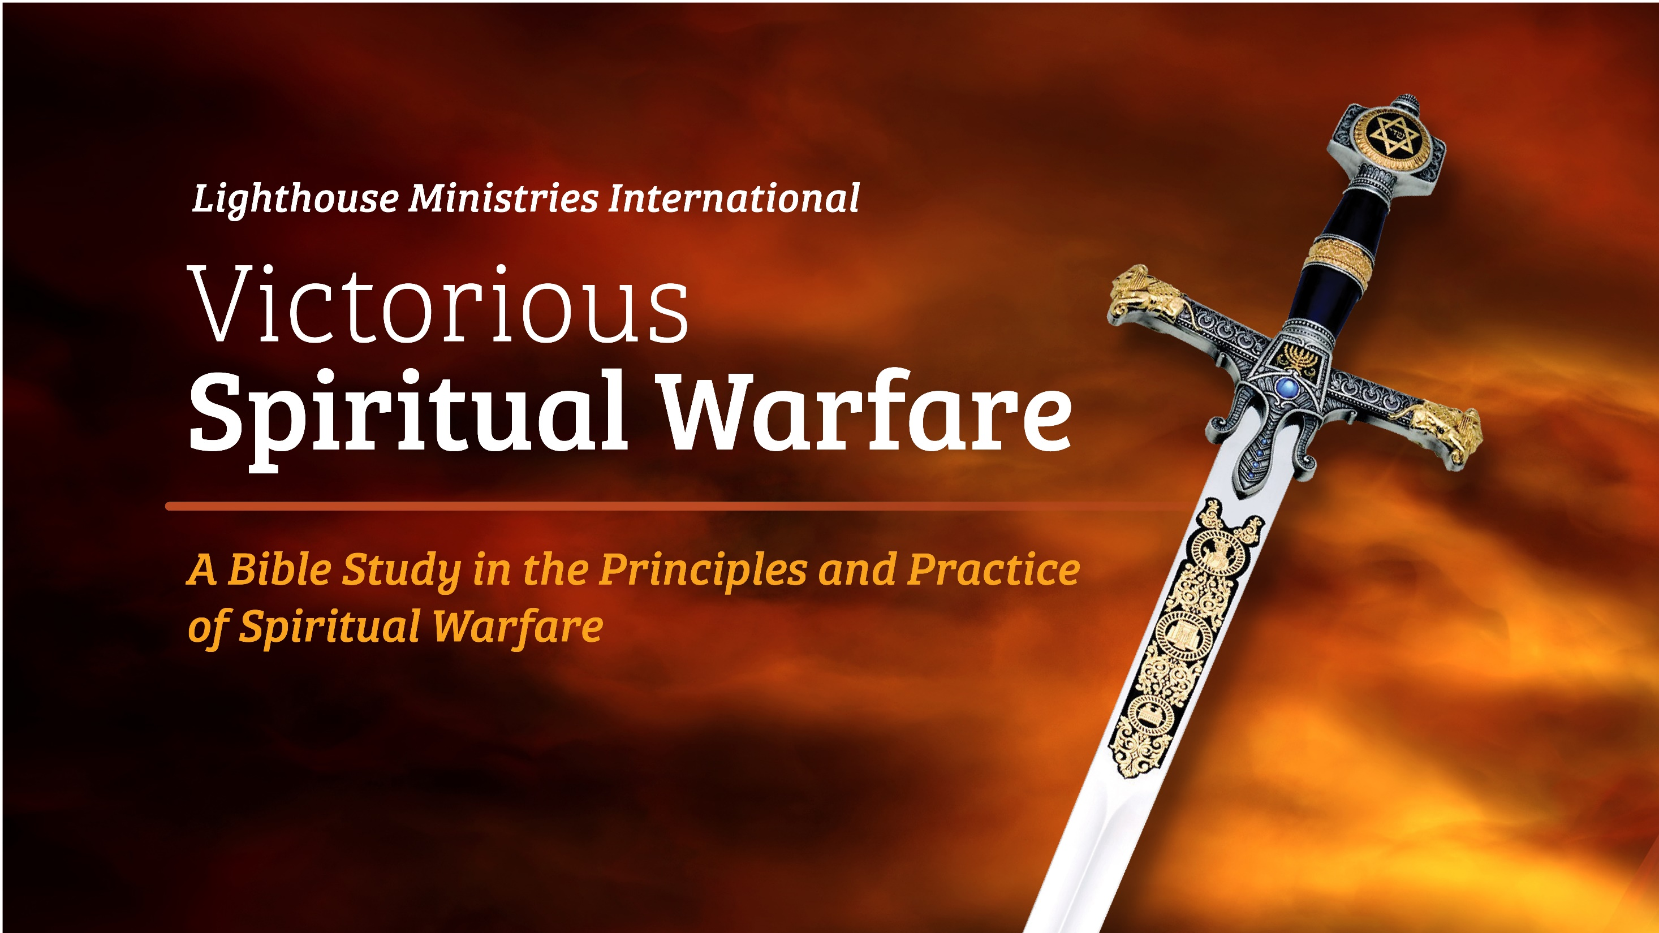
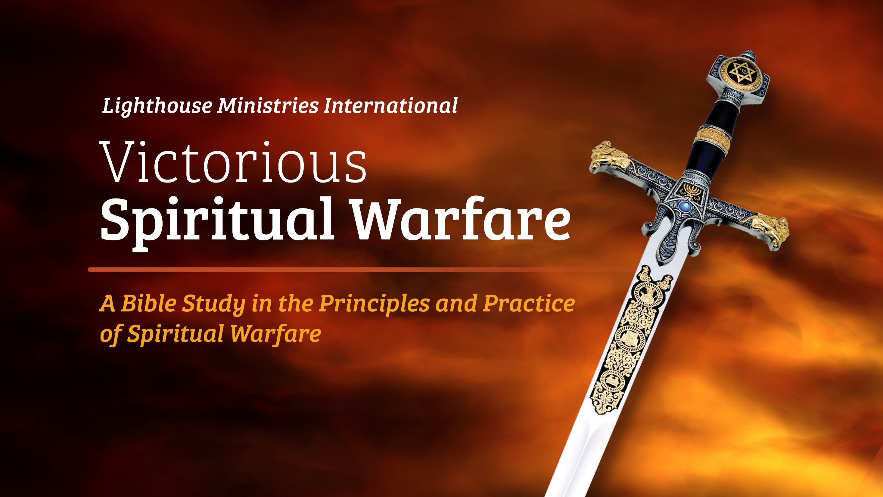

Slide 2
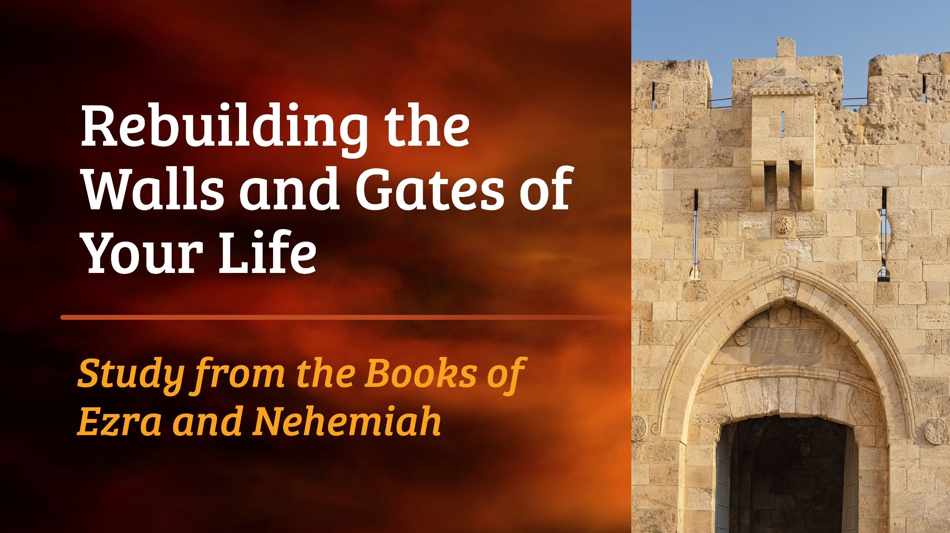

Slide 3
Rebuilding Your Worship Center
(Main texts: Ezra, 2 Chronicles 26)
John 4:23, 24
But an hour is coming, and now is, when the true worshipers will worship the Father in Spirit and in truth. For the Father also seeks such ones to worship Him. God is a Spirit and the ones worshipping Him must worship in Spirit and truth.

Slide 4
Old Testament Foundation
In Exodus 4, God raised up a deliverer in Moses.
What are the three signs God gave Moses in answer to his complaint that the people would not accept his claim that he had been given authority by God to free His people from bondage?
1.
2.
3.

Slide 5
When the Messiah came, He came with a new authority for setting captives free (Luke 4:18). In Matthew 10:1, Mark 3:14, 15, and Luke 9:1, 2, what three things were the twelve given authority to do?
1.
2.
3.
The validation of God’s direct authority is crucial in the arena of spiritual warfare. In the spiritual arena, restoring worship is an aggressive act against the “god of this world”, to take away his claim on God’s people.

Slide 6
Read Exodus 5:1. To what end did God demand the release of His people from bondage to Pharaoh?
Exodus 8:1 repeats this command with a slight difference. What is it?
Compare this with Romans 12:1. In submitting ourselves as a living “sacrifice”, what does the passage call this?

Slide 7
In 630 B.C. while under Persian rule, King Josiah’s reforms brought revival to Israel and he began repairing the temple (2 Chronicles 34). He also recovered the temple treasures.
Read 2 Corinthians 4:7.
What “treasures” are entrusted to us?

Slide 8
In 624 B.C., Hilkiah the priest recovers the Book of the Law (2 Chronicles 34:18-21). When the Word of the Lord was read, the King rent his clothes, for he realized the terrible price that had been paid as a result of ignorance of God’s law in the land.
In the Fall of 1993, I felt like tearing my clothes!!!
Read Isaiah 5:13.
What terrible price have we or others paid for lack of knowledge concerning these things? (See Luke 11:52)

Slide 9
By 539 B.C., God’s people had again become hard of hearing and unobservant of God’s desires. The prophet, Haggai (1:4), proclaimed the judgment that had come for God’s people honoring their own personal lives with “paneled houses”, while the God’s temple lay “desolate”. The rebuilding began as an act of honor to the true treasures given to God’s people, even His very presence among them. But the building stopped when opposition from neighbors was too great.
What does it take to hinder this process in our lives?

Slide 10
It was the grandson of Hilkiah the priest, Ezra, who finally picked up the process again in 536 B.C., when (2 Chronicles 36) we find an ungodly ruler, Cyrus King of Persia, giving a strange command.
2 Chronicles 36:23
'The LORD, the God of heaven, has given me all the kingdoms of the earth, and He has appointed me to build Him a house in Jerusalem, which is in Judah. Whoever there is among you of all His people, may the LORD his God be with him, and let him go up!'
What does Proverbs 21:1 say about God’s sovereignty over those in power?

Slide 11
The Messiah made true worshippers of us by making our _____________ the temple where God’s presence dwells.
(1 Corinthians 3:16)
and His _________________ the treasure in the temple.
(Colossians 1:27)
Now that we see what the great treasure in our “city” is, let’s look at what Nehemiah teaches us about protecting it.

Slide 12
KEY TRUTH:
In order to stay free, our life needs new spiritual walls and gates (boundaries) to serve as protection against spiritual attack.
The prophet wrote: "The gates of your land are opened wide to your enemies; fire consumes your gate bars." (Nahum 3:13)

Slide 13
New Testament Application
What does 2 Corinthians 11:3, 4 warn Christians about?
What instruction do we find in 1 Thessalonians 5:21, 22 ?

Slide 14
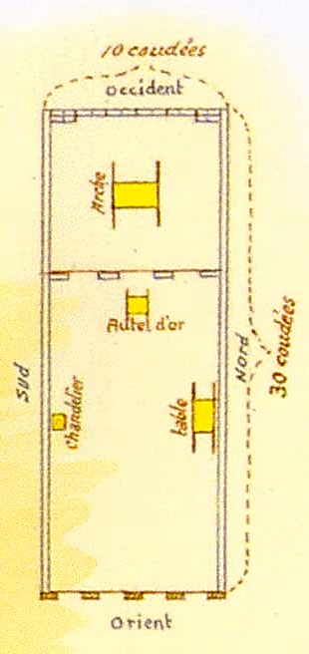
The Ark of the Covenant represents the treasure chest of the heart.
(Matthew 6:21)
Altar of Incense: the will of man – to be submitted in prayer at all times.
(Revelation 5:8, 8:3)
The Lampstand of the Mind.
(Proverbs 23:7)
The showbread corresponds to the emotions and desires.
(Matthew 4:3)
The compartments of the Tabernacle correspond to our own make-up.
The Holy place, corresponding to the SOUL of man where the MIND illuminates in order to tend to the WILL and EMOTIONS.

Slide 15
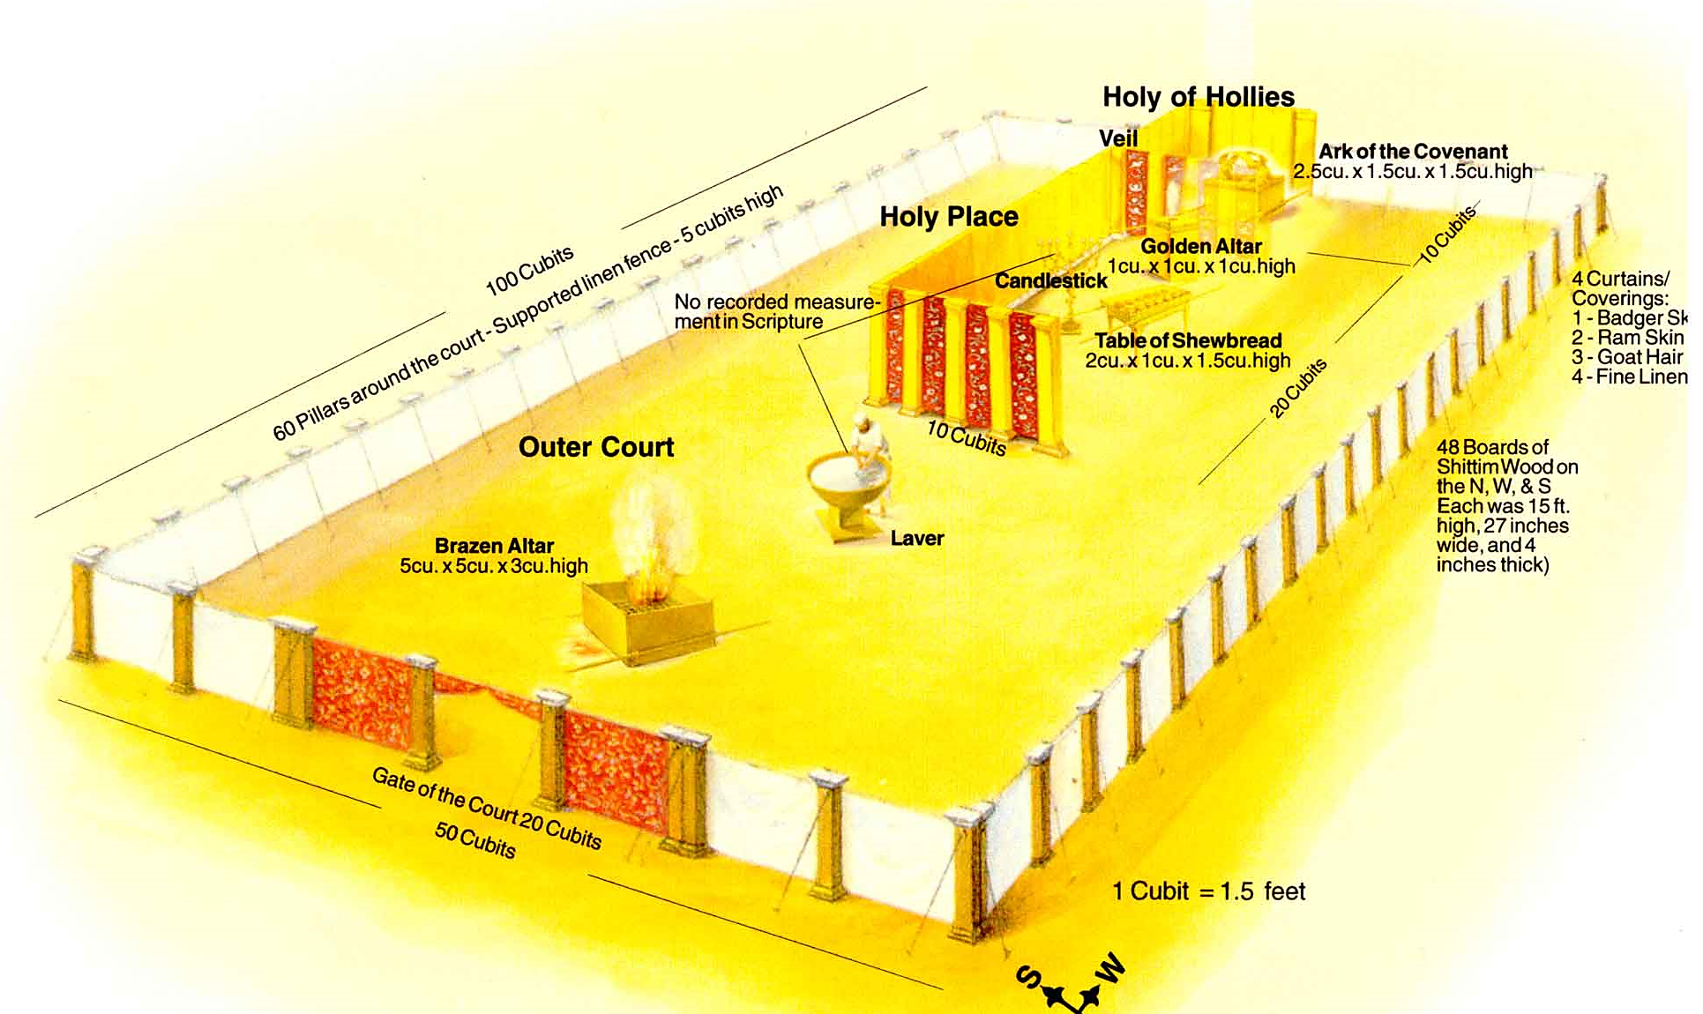
The Tabernacle represents our own body..
SPIRIT
dwells here
BODY
Tabernacle/Temple
SOUL

Slide 16
Walls and Gates
Jerusalem – 550 B.C.

Slide 17
KEY VERSE:
Isaiah 60:18
Violence will not be heard again in your land, nor devastation or destruction within your borders; but you will call your walls salvation, and your gates praise.

Slide 18
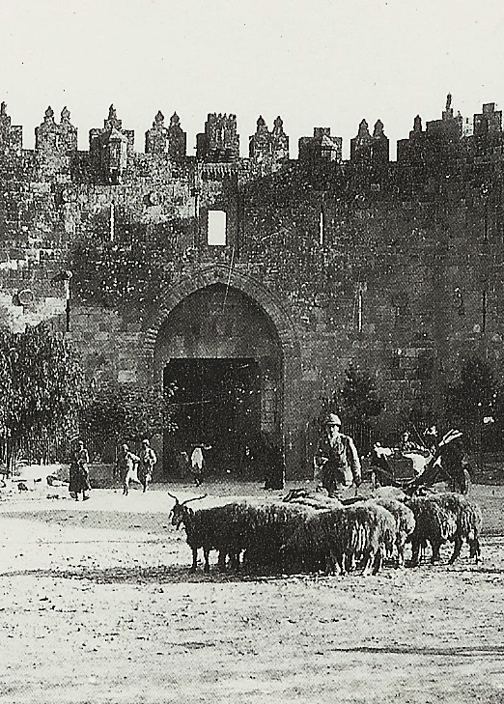
II. The Sheep Gate
Nehemiah 3:1
This gate led directly to the Temple.
God is committed to restoring our relationship with Him.
Our worship time must be guarded at
all costs.
Built by the high priests and fellow priests – why do WE qualify? (1 Peter 2:9)
What is our “sacrifice”? (Romans 12:1)

Slide 19
II. The Fish Gate
Rebuild the Word of God in your Life.
Fish were brought in daily from the Jordan River and the Sea of Galilee.
As we intake the fresh Word daily, we are able to discern between good and evil in our daily life.
(2 Timothy 3:16-17)
Our Lord provided _________ for the disciples after His resurrection? (John 21:12)

Slide 20
III. The Old Gate
Rebuild defenses against all unclean coming into the world.
Was rebuilt and sealed so that it could not be used!
Rebuilt by Jehoiada which means "to know Jehovah". (See 1 John 2:15)
We now close off all activities and relationships that connected us to the old life of defeat and bondage.

Slide 21
IV. The Valley Gate
Be on guard against the subtle attacks of the enemy.
Where the enemy usually attacked because a hidden approach to the wall was possible.
Built by Hanun which means "to submit“ – our first and foremost command. (James 4:7)
Satan has an old strategy file on you! Valley Gate tactics are very subtle and often do not seem to be demonic attacks. (1 Peter 5:8)

Slide 22
V. The Dung Gate
Daily clean out the sin rubbish. (Nehemiah 3:14)
Built by Malchiah which means "son of Jehovah” – only God’s sons (Galatians 4:7) can be forgiven of sin.
This gate lead to the Valley of Hinnon, or Gehenna – meaning "a habitation of demons“.
Unconfessed sin can become a habitation for demons.
Daily the garbage from the city would be carted out to the Valley of Hinnon. Apply 1 John 1:9.

Slide 23
VI. The Fountain Gate
The Fountain Gate was built by Shallum which means “to restore”.
Jesus is our Restorer. Be cleansed by drinking the pure water of the Word of God. We drink living water from Jesus who is our fountain of life.
Read Psalm 36:9
The residents of Jerusalem would come to wash their dusty hot feet at the Fountain Gate. Are you feeling dirty or polluted by the world? Go to the water of the Word, wash and be clean.
(Hebrews 10:22)

Slide 24
VII. The Water Gate
The Water Gate led to the King's Garden and the Gihon Spring. The King's Garden was a beautiful lush garden by the quiet Pool of Siloam where the king would come to enjoy solitude and restoration.

Slide 25
Siloam: “to send away”
This same pool was where Jesus applied clay to the blind man's eyes and told him to go and wash in the Pool of Siloam. He obeyed and came back seeing. It is in the obedient act of coming apart to the quiet still waters of the Lord's presence that we will have our sight renewed and be fully restored. Jesus went away often to a solitary place to pray and be refreshed.
Matthew 14:23 | Mark 1:35 | Mark 6:46
John 9:1-11 | Psalm 23: 1-3 | Luke 11:1

Slide 26
The Garden is for Fellowship
God first met with Adam in a garden (Genesis 2:8, 3:8). The King's Garden inside the Water Gate represents the place of beautiful solitude. Our city (life) must have this quiet place where we meet our King. Jesus met His Father in the Garden on the Mount of Olives and the Garden of Gethsemane. (Matthew 26:36, 39)
Where is your “garden”?

Slide 27
Consider the Well of your City
The Water Gate led to the main water source for the city of Jerusalem, the Gihon Spring. It was here where the Scriptures were read publicly in an open area. (Nehemiah 8:1, 5, 6, 10)
The word Gihon means "to gush forth". We need to gather with other brothers and sisters to read and meditate on the Word of God.
The gathering together of the saints for the study of the Word is like coming to a gushing spring to drink. When we take in the Word, the joy of the Lord becomes our strength.
(John 15: 7- 11)

Slide 28
VIII. The Horse Gate
The Horse Gate was opened when the King's horses and troops were marching out to war. The King's horses and troops were kept in a constant state of readiness. (1 Peter 5:8)
The priests built this gate when they were not tending to their priestly duties. We are first called to be worshippers of the Lord Jesus Christ and secondly, rebuilders and warriors.

Slide 29
We are to be an Enduring City
The defense of the city was perpetual. We need to understand that the battle is over when we reach heaven. Until then, we are called to "stand and withstand". Observe how the Bible phrases this truth: Luke 12:35 and Ephesians 6:13 (KJV).
God declared through the prophet Jeremiah that the city would be rebuilt and never overthrown again.
It would be Holy to the Lord. (Jeremiah 31:38-40)

Slide 30
IX. The East Gate
The Gate on the East had direct access to the Temple. It is mentioned in Scripture as the Gate through which the Lord Jesus Christ will come to take His rightful place as the Prince of Peace on earth.
Today it still stands – sealed. It is called the Gate of the Messiah.
Read Ezekiel 44:1-3 to see why.

Slide 31
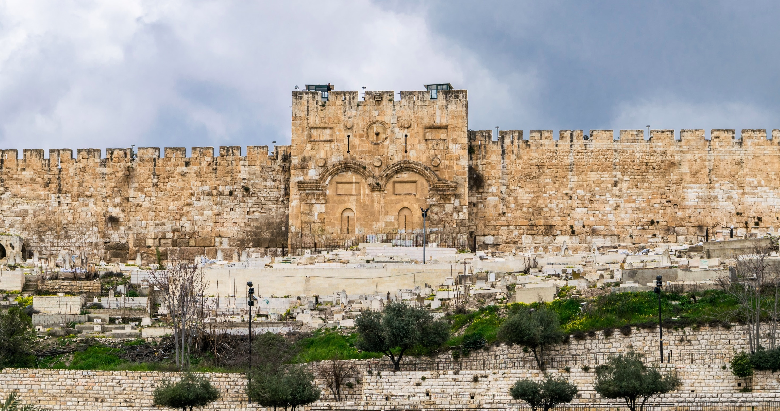
Gate of the Messiah as it Appears Today
The Tabernacle represents our own body..

Slide 32
East Gate was built by Shemaiah
Shemaiah that means "the Lord Jehovah has heard".
We know that the Lord is attentive to our cry:
"Come Lord Jesus.” (Revelation 22:20)
Our hope is the fact that our Lord is returning to gather us to Himself. Then, we will be with Him when He returns to rule and reign. We have a glorious future. (1 Corinthians 15:51-58)

Slide 33
X. The Inspection Gate
The Inspection Gate was also called the "Muster Gate". It was here that documents were inspected before visitors were allowed to come in. A sentry post was stationed at this gate.
The Inspection Gate was built by Malchijah which means "appointed by the king" or "of the king".

Slide 34
Application
We need to inspect the source and identity of all that comes to OUR gates.
Identity is established by documentation:
Acts 17:11 – Is it Consistent with Scripture?
Legitimacy is shown by results:
Matthew 7:18-20 – Is it Confirmed by fruit?
Source is determined by confession:
1 John 4:1-3 – Is it Confessing Jesus Christ?

Slide 35
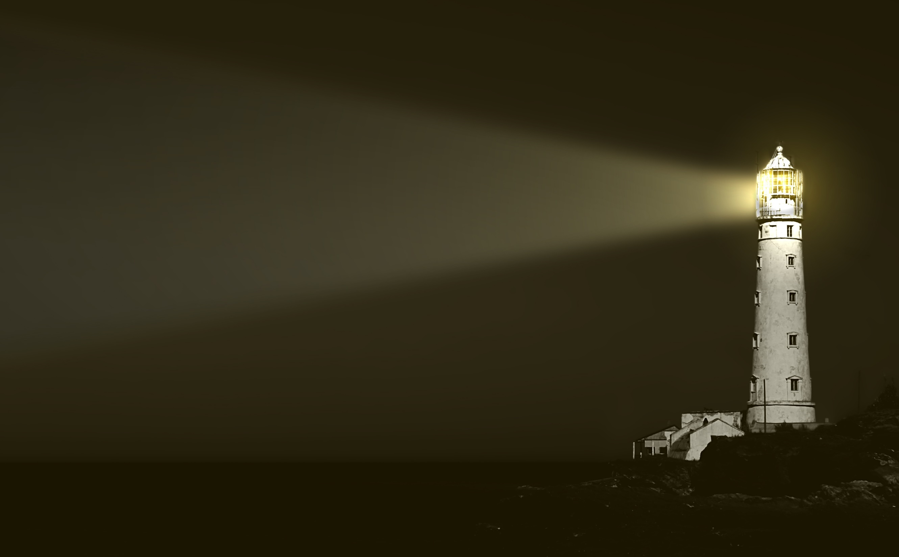
Lighthouse Ministry International
Home Office
P.O. Box 120297 | St. Paul, MN 55112
For Ministry Appointments
(651) 483-0888
Email
info@LighthouseMinistryIntl.org
Web
LighthouseMinistryIntl.org

